Slide 1
Power Management
Instructor: Zonghua Gu
Notes:
1. Sources of Power Dissipation
2. Reducing Power Consumption
3. System Level Power Optimization
4. Dynamic Power Management
5. Mapping and Scheduling for Low Energy
6. Real-Time Scheduling with Dynamic Voltage Scaling

Slide 2
The Case for Power Awareness
Limited availability
Energy and power uses of new devices is markedly different from laptops and notebook computers
much wider dynamic range of power demand
increasing share of memory, communication and signal processing
multiple power use modalities depending upon application
“immortal”, “paging-mode RX”, “lifeline TX”, “mission-mode”

Slide 3
Where does the Power Go?
Peripherals
Processing
Disk
Display
Programmable
μPs & DSPs
(apps, protocols etc.)
ASICs
Memory
Power Supply
DC-DC
Converter
Communication
Radio
Modem
RF
Transceiver
Battery

Slide 4
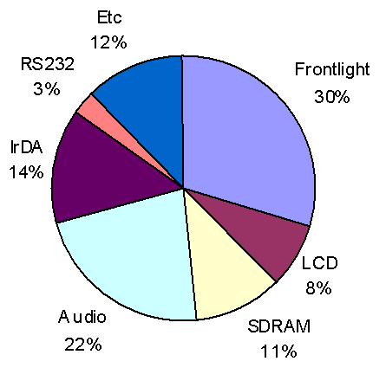
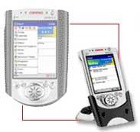
Example: Power Consumption for Compaq’s iPAQ
206MHz StrongArm SA-1110 processor
320x240 resolution color TFT LCD
Touch screen
32MB SDRAM / 16MB Flash memory
USB/RS-232/IrDA connection
Speaker/Microphone
Lithium Polymer battery
PCMCIA card expansion pack & CF card expansion pack
* Note
CPU is idle state of most of its time
Audio, IrDA, RS232 power is measured when each part is idling
Etc includes CPU, flash memory, touch screen and all other devices
Frontlight brightness was 16

Slide 5
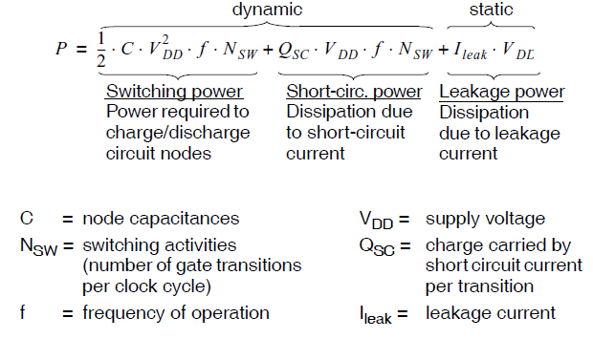
Power Consumption in CMOS Devices (CPU)

Slide 6
Leakage vs. Dynamic
Leakage power (static power) is consumed even if the circuit is idle (standby mode). The only way to avoid it is to turn off the CPU.
Short circuit power is around 10% of total power.
Switching power is still the main source of power consumption.
In the past, Leakage power was considered negligible compared to dynamic power.
Today, Leakage power is approaching or exceeding size of dynamic power.

Slide 7
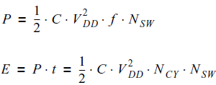
Power vs. Energy
When we only consider dynamic switching power:
N_{CY}=number of CPU cycles to finish running the task
Sometimes we are concerned about power consumption:
- heath dissipation, cooling:
- physical deterioration due to temperature.
• Sometimes we want to reduce total energy consumption:
- battery life.

Slide 8
Reducing Power/Energy Consumption
The main sources:
Reduce supply voltage V_{DD}
Reduce switching activity N_{SW}
Reduce capacitance C
Reduce number of cycles N_{CY}=f*t

Slide 9
Reducing Power/Energy Consumption (Cont’)
Circuit level
Transistor sizing
Logic level
Clock gating
Behavioral level
High-level synthesis techniques
Architecture level
Special instruction set, bus segmentation…
System level
Our focus

Slide 10
System-Level PM
Static techniques are applied at design-time.
Compilation for low power: instruction selection considering their power profile, data placement in memory, register allocation.
Algorithm design: find the algorithm which is the most power efficient.
Task mapping and scheduling.
Dynamic techniques are applied at run-time.
Reduce power consumption by exploiting idle or low-workload periods.

Slide 11
3 Techniques
We discuss three techniques:
1. Task mapping: static technique.
2. Task scheduling with DVFS: static & dynamic.
A device can be run at different speeds at different power levels
Execution of jobs can be slowed down to save power as long as all jobs are completed by their deadline.
3. Dynamic power management: dynamic technique.
When a device is idle, it can transition to low-power “sleep” states.

Slide 12
Task Mapping & Scheduling

Slide 13
Mapping & Scheduling: Static Technique
For many embedded systems, DPM/DVFS techniques may not be applicable:
OS is small ⇒ no sophisticated PM techniques at run-time.
Time constraints ⇒ cannot afford frequent shut-down and wake-up times.
System is application-specific ⇒ the application is known at design time
Static techniques can be used at design time.
Notes:
They have no devices like hard-disk, no (or small) display ⇒ VLSI is a main source of power dissipation.

Slide 14
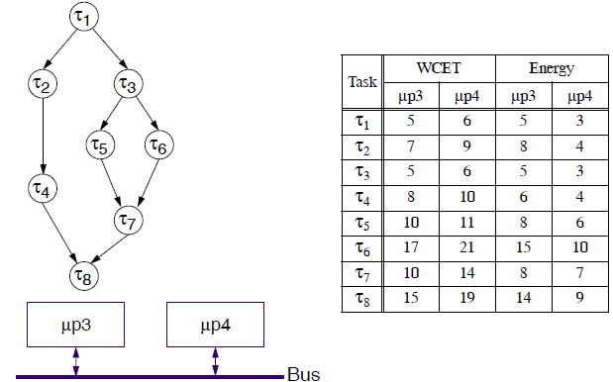
Example: minimize total energy
Processor up4 is slower and more power efficient than up3
Problem: find a feasible mapping and scheduling to minimize total energy consumption

Slide 15
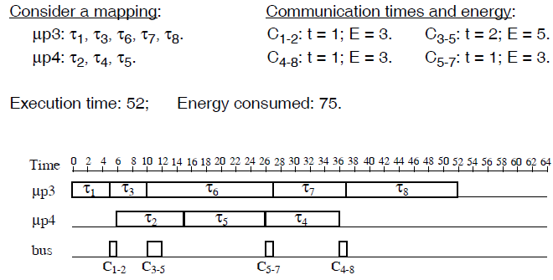
One Solution

Slide 16
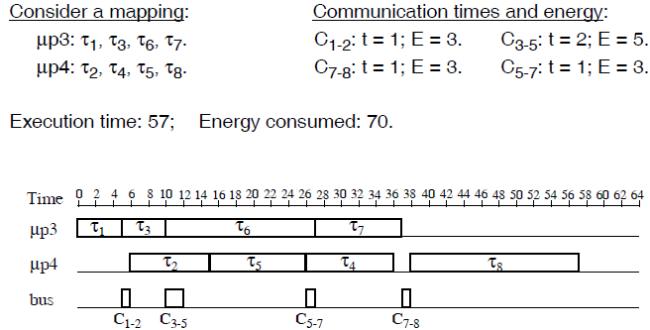
Another Solution

Slide 17
2nd Solution is Better
For real-time systems, task finish time is not important, as long as it meets its deadline
If task graph deadline is 60, then 2nd solution with τ8 on μp4 is preferable, even if it is slower
The 2nd solution consumes less energy

Slide 18
Dynamic Frequency/Voltage Scaling (DVFS )

Slide 19
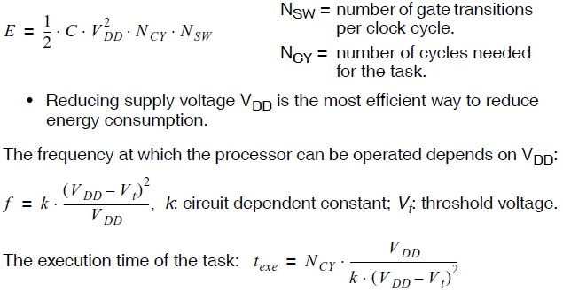
Recall Switching Energy Consumption
Often assume f=k*V_{DD}, for simplicity.

Slide 20
DVFS-Enabled Processors
Several supply voltage levels are available.
Supply voltage can be chosen by the OS through execution of particular instructions.
Frequency is automatically adjusted to fit the current supply voltage.
Most modern processors are DVFS-enabled.

Slide 21
Scheduling w/ DVFS
The scheduling problem:
Which task to execute at a certain moment on a certain processor so that time constraints are fulfilled?
The scheduling problem with voltage scaling:
Which task to execute at a certain moment on a certain processor, and at which voltage level, so that time constraints are fulfilled and energy consumption is minimized?
Key problem: reducing supply voltage increases execution time!

Slide 22
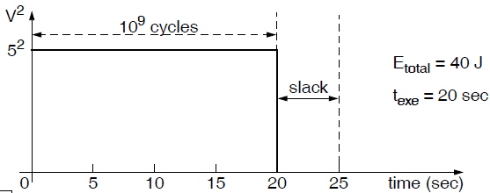
Example
Consider a task τ, and CPU runs at full speed until τ finishes:
total computation: 109 execution cycles.
deadline: 25 seconds.
processor nominal (maximum) voltage: 5V.
Energy per cycle: 40 nJ/cycle at nominal voltage.
CPU frequency: 50MHz (50 million cycles/sec) at nominal voltage.

Slide 23
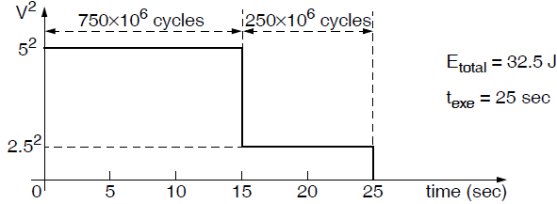
Reduced Voltage & Frequency
Reduce voltage at time 15: set V_{DD} = 2.5V
Energy per cycle: 40*(2.5/5)² = 10nJ/cycle.
CPU frequency: 50*(2.5/5) = 25MHz

Slide 24
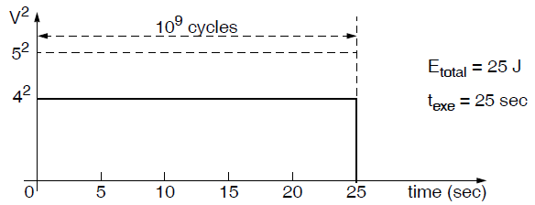
Reduced Voltage & Frequency
Reduce voltage at time 0: V_{DD} = 4V
Energy per cycle : 40*(4/5)² = 25nJ/cycle.
CPU frequency: 50*(4/5) = 40MHz

Slide 25

Basic Principle
If a processor uses a single supply voltage and completes a program just on deadline, the energy consumption is minimized.
Consider two tasks τ1, τ2: τ1 precedes τ2 :
Computation
τ1: 250 million execution cycles; τ2: 750 million execution cycles;
Deadline: 25 seconds.
Processor nominal (maximum) voltage: 5V.
Energy per cycle:
40 nJ/cycle at nominal voltage V_{DD}=5V.
25 nJ/cycle at reduced voltage V_{DD} = 4V.
Processor speed:
50MHz at nominal voltage.
40MHz at reduced voltage.

Slide 26
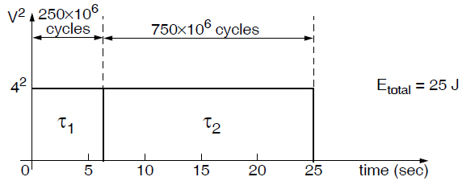
Basic Principle Cont’
To minimize total energy consumption, Find the constant voltage so that the tasks just meet their deadline

Slide 27
Dynamic Power Management (DPM)

Slide 28
Dynamic Power Management (DPM)
OS makes decisions to
Switching among multiple power states: idle, sleep, run
Target can be CPU or peripheral devices
Goal:
Minimize power or energy consumption
Satisfy QoS constraints
Notes:
Switching among multiple frequencies and voltage levels.

Slide 29
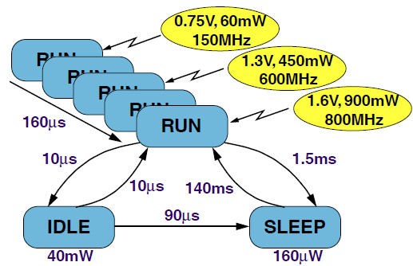
Intel XScale Processor
CPU power states:
RUN: operational
IDLE: CPU clocks are disabled; recovery through interrupt.
SLEEP: Mostly powered off; recovery through wake-up event.
Other intermediate states (not drawn): DEEP IDLE, STANDBY, DEEP SLEEP

Slide 30
DPM
The power breakdown for a laptop computer:
36% of total power consumed by the display
18% by hard-disk
18% by wireless LAN interface
7% by keyboard, mouse, etc.
21% by CPU
DPM techniques are used in laptops, PDAs, etc.
Implemented in the OS

Slide 31
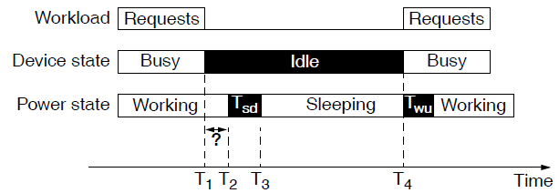
Basic Concept of DPM
When there are requests for a device ⇒ the device is busy; otherwise it is idle.
When the device is idle, it can be shut down to enter a low-power sleeping state.

Slide 32
Basic Concept of DPM Con’t
Changing the power state takes time (up to several seconds) and extra energy.
T_{sd} : shutdown delay
T_{wu} : wake-up delay
Send the device to sleep only if the saved energy justifies the overhead!
Design decisions:
Don’t shut down if delays occur too frequently.
Don’t shut down if power savings due to sleeping are smaller than the power overhead of the state changes.

Slide 33
PM Policies
PM policies are based on predictions related to idle periods:
For shut-down: try to predict how long the idle period will be in order to decide if a shut-down should be performed. Typical Policies:
1. Time-out
2. Predictive
3. Stochastic
For wake-up: try to predict when the idle period ends, in order to avoid user delays due to T_{wu}.
It is very difficult; typical policy is to simply wake up when a request arrives.

Slide 34
Timeout Policy
Shut down when the device has been idle for a time period τ (the interval T1 – T2 on slide 15).
Drawback: energy is wasted during the idle period τ (compared to instantaneous shut-down).
Possible policies:
Fixed time-out period: you set the value of τ, which then stays constant.
Adjusted at run-time: increase or decrease τ, depending on the length of previous idle periods.
Notes:
, it will stay idle for at least a period which makes it efficient to shut down

Slide 35
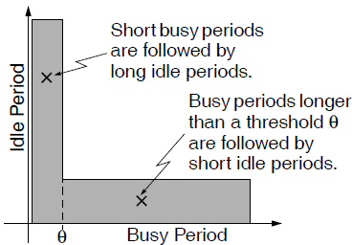
Predictive Policy
Predict the length of the future idle period. If the predicted idle period length is long enough, shut down immediately (no time interval T1 - T2 on slide 15).
Policy: assume L-shaped distribution for (Idle Period)/(Previous Busy Period)
Shut down immediately after a short busy period, but not immediately after a long busy period

Slide 36
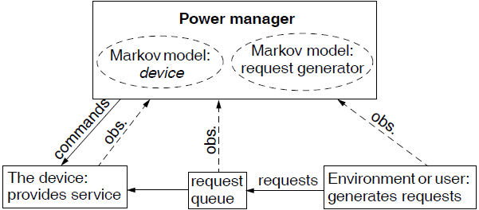
Stochastic Policy
Predictions are based on Markov models: requests and power state transitions of the device are modeled as probabilistic state machines.
OS power manager observes the arriving requests and the request queue, and generates shutdown commands.

Slide 37
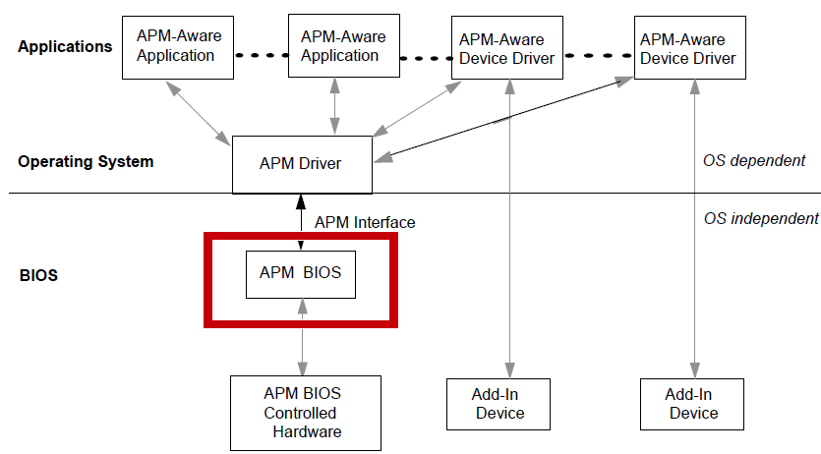
Advanced Power Management (APM)
APM is part of the BIOS
OS/BIOS co-operation: when OS goes to idle, it performs an access to a register that causes an SMI (System Management Interrupt)
SMI handler puts system into low power state
APM required OS to trust the system BIOS
Notes:
Supported by Microsoft’s desktop operating systems via APM - Advanced Power Management
OS/BIOS co-operation
When OS goes to idle condition it performs an access to a register that causes an SMI#
SMI handler puts system into low power state
APM required OS to trust the system BIOS

Slide 38
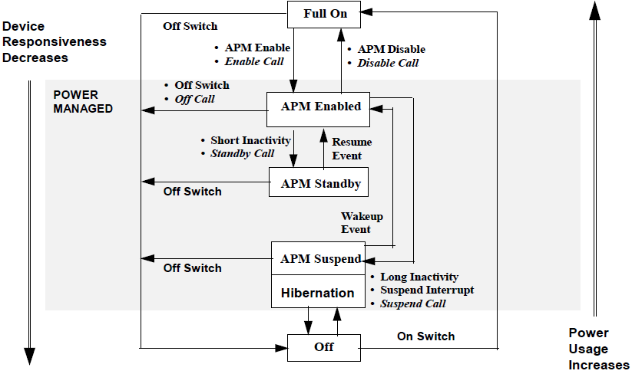
APM Power State

Slide 39
Current OSPM – ACPI
Advanced Configuration and Power Management Interface (ACPI)
Based on OS instead of BIOS (APM)
Standard way for the system to describe its device config. & power control h/w interface to the OS
register interface for common functions: system control events, processor power and clock control, thermal management, and resume handling
Info on devices, resources, & control mechanisms
Thermal Management
Notes:
OS/drivers/BIOS are in sync regarding power states

Slide 40
ACPI Architecture

Slide 41
ACPI Power States

Slide 42
Overview of ACPI System States
State
CPU
Memory
Devices
Wake Up
Context Tracking
G0
C0: Executing @ Full Speed
C1:C3 Executing in PM state
(ie Thermal Throttle/HLT)
Retained
Power: ON
Refresh: Normal
Powered Up & Down
based on demand
D0-D3
Working
S1
Not Executing
Context Retained
CPU CLK: OFF
System CLK: ON
Power: ON
H/W responsible for saving
context of CPU, System I/O,
& Memory
Retained
Power : ON
Refresh : Normal
Devices Power down
depending on wakeup &
power requirements
Lowest Latency
Restart @ CS:IP +1
Sleeping
S2
Not Executing
CPU/Sys Cache Context Lost
CPU CLK: OFF
System CLK: OFF
Power: ON
Retained
Power : ON
Refresh : Standby /
Auto
Devices Power down
depending on wakeup &
power requirements
H/W responsible for saving
context of System I/O & Memory
OS responsible for saving CPU
context
Latency > S1
Restart @ Boot Vector
Sleeping
S3
Not Executing
CPU/Cache Context Lost
CPU CLK: OFF
System CLK: OFF
Power: OFF
Retained
Power : ON
Refresh : Standby /
Auto
Devices Power down
depending on wakeup &
power requirements
Latency > S2
Restart @ Boot Vector
H/W responsible for saving
Memory context BIOS restores
Memory Controller
Context. OS responsible for saving
CPU & System I./O context
Sleeping
S4
Not Executing
CPU/Cache Context Lost
Everything: OFF
Context Lost
Power : OFF
Refresh : N/A
Devices Power down
depending on wakeup &
power requirements
Latency > S3
Restart @ Boot Vector
OS(S4) / BIOS(S4bios) is
responsible for saving and restoring
all system context, including memory
S4BIOS
Sleeping
G2/S5
OFF
OFF
Devices are OFF,
Power Button Press will
wake up the system
Latency > S4
Restart @ Boot Vector
OS uses S5 to turn the machine off
Soft OFF
NOTES:
- OS chooses the lowest supported sleep state in which all enabled wakeup devices still functions under the latency requirements from apps.
- ASL binds each Sx state to a SLP_TYP value, which based on platform design of power planes & clocking logic det what portions of the h/w power down.
- For each Device, ASL lists which power resources are needed to maintain a ‘wakeup’ capable state
- ‘System I/O’ refers to Motherboard Devices: PIT, PIC, DMAC, NMI State....OS saves & restores this stuff for S3

Slide 43
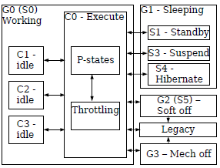
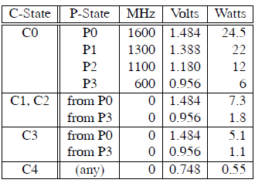
ACPI Processor Power States
Latency
C1 < C2 < C3
Power
C1 > C2 > C3
Notes:
Note that
these numbers reflect processor power, and do
not include other system components, such as
the LCD chip-set, or disk drive. Note also that
on this particular model, the savings in the C1,
C2, and C3 states depend on the P-state the
processor was running in when it became idle.
This is because the P-states carry with them reduced
voltage.

Slide 44
Summary of functional areas covered by ACPI
G0—System Working State.
P-states have meaning only in the context of a running system— not when the system is in one of its various sleep or off-states.
Processor C-state:
C0 is the executing CPU power state. C1–Cn are idle CPU power states used by the Linux idle loop; no instructions are executed in C1–Cn. The deeper the C-state, the more power is saved, but at the cost of higher latency to enter and exit the C-state.
Processor P-state:
Performance states within C0-state, consist of states representing different processor frequencies and voltages.
Processor T-state
Throttle states within C0-state, change the processor frequency only, leaving the voltage unchanged.
On a system with both P-states and T-states, Linux uses T-states only for thermal (emergency) throttling.

Slide 45
Summary of functional areas covered by ACPI
System Power Management
ACPI defines mechanisms for putting the computer as a whole in and out of system sleeping states.
Device Power Management
ACPI tables describe devices, their power states, the power planes the devices are connected to, and controls for putting devices into different power states.
Processor power management
While the OS is idle but not sleeping, it will use commands described by ACPI to put processors in low-power states.
Device and processor performance management
DPM to achieve desirable balance between performance and energy by transitioning devices and processors into different states when the system is active.

Slide 46
ACPI functionalities (cont.)
Plug and Play
hierarchically arranged device and configuration information
System Events
a general event mechanism for system events such as thermal events, power management events, docking, device insertion and removal, and so on
Battery management
either through a Smart Battery subsystem interface controlled by the OS directly through the embedded controller interface, or a Control Method Battery interface.
Thermal management
provides a model to allow OEMs to define thermal zones, thermal indicators, and methods for cooling thermal zones.
A standard hw and sw interface between OS and Embedded Controller
allows any OS to provide a standard bus enumerator that can directly communicate with an embedded controller in the system, thus allowing other drivers within the system to communicate with and use the resources of system embedded controllers.

Slide 47
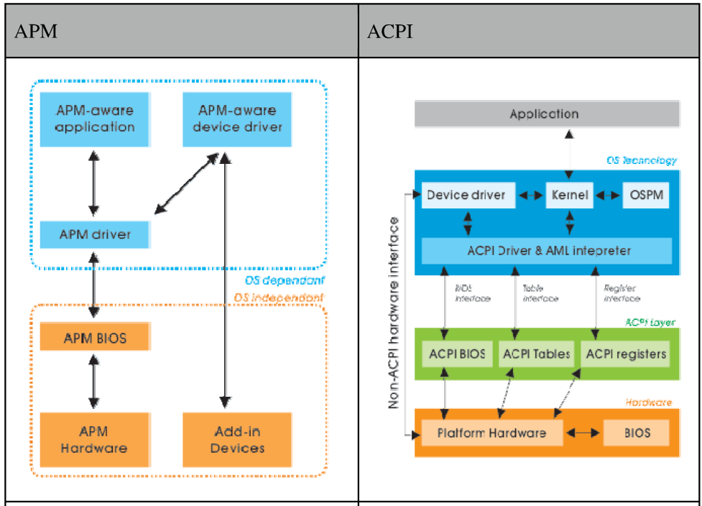
APM vs. ACPI
APM:
Control resides in BIOS
Uses activity timeouts to determine when to power down a device
BIOS rarely used in embedded systems
Makes power-management decisions without informing OS or individual applications
ACPI
Control divided between BIOS and OS
Decisions made by the OS
Enables sophisticated power policies for general-purpose computers with standard usage patterns and hardware
Notes:
ACPI: No knowledge of device-specific scenarios (e.g. need to provide predictable response times or to respond to critical events over extended period)
No knowledge of new devices (e.g. USB, IEEE 1394)

Slide 48
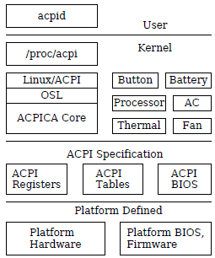
ACPI in Linux
The box labeled “Linux/ACPI” represents the Linux-specific ACPI code, including boot-time configuration.
Optional “ACPI drivers,” such as Button, Battery, Processor, etc. are (loadable) kernel modules that implement policy related to those specific features and devices.
There are about 200 ACPI-related files in the Linux kernel source tree—about 130 of them are from ACPICA, and the rest are specific to Linux.

Slide 49
Microsoft’s OnNow
Win32 API extension Based on ACPI; allows applications to
affect the power management decision making
adapt to power state
find out if running on batteries so as to reduce processing
discover disk state & postpone low priority I/O, e.g. paging
Requires changes in hardware, firmware (BIOS), OS, and application software
bus & device power management standards for h/w
ACPI interface standard between OS & hardware
integration of power management into app control

Slide 50
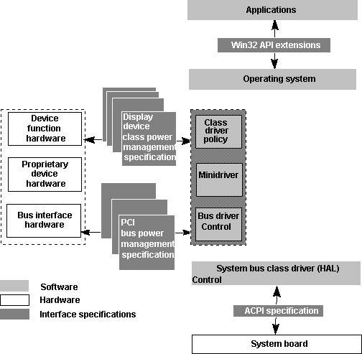
OnNow Components
Ref.: Microsoft’s “OnNow Power Management Architecture for Applications”

Slide 51
OnNow Architecture
User’s view: system is either on or off
Reality: system transitions among a number of “power states” according to OS’s power policy
Global power states
working: apps are executing
sleep: software is not executing, & CPU is stopped
OS tracks user’s activities & application execution states to decide when to enter sleep monitor user input, hints from applications
wake-up is time-based or device-based
off: system has shutdown and must reboot

Slide 52
OnNow Architecture (contd.)
Full on
Device and processor power
conservation occurring
according to system usage
Working
power switch
wake-up
idle
Appears Off
Processor stopped; devices off
Wake-up events enabled
Timed wake-up enabled
Sleeping
Soft Off
Off
power switch
Able to turn on electronically
OnNow Global Power States
Ref.: Microsoft’s “OnNow Power Management Architecture for Applications”

Slide 53
OnNow Architecture (contd.)
Power states for individual devices
managed by device drivers while system is “working”
function of application needs, device capabilities, and OS information
e.g. shutdown serial port if not in use
Power states for CPU
OS transitions CPU between its various low-power states based on CPU usage
function of power source, processing time, user preferences etc.
API mechanisms
for apps to learn about power events & status from OS
for apps to tell their requirements to the OS

